Slide 1
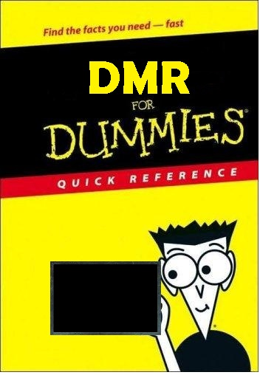
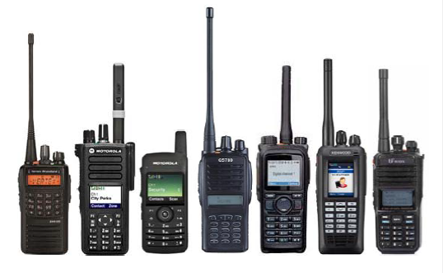
The DMR Basics & No Frills
What is DMR?
Digital vs. Analog
Time Slots [TDMA] & Talk Groups
Zones
Color Codes
Code Plugs
Scanning and Roaming
Simplex
Admit Criteria
Repeater Access
Basic Programming

Slide 2
DMR for DUMMIES
Digital Mobile Radio (DMR) was developed by the European Telecommunications Standards Institute (ETSI) and is used worldwide by professional mobile radio users. [http://www.dmrassociation.org]
DMR is divided into three tiers.
Tier I is a single channel specification originally for the European unlicensed dPMR446 service. It is a single channel FDMA 6.25 kHz bandwidth; the standard supports peer-to-peer (mode 1), repeater (mode 2) and linked repeater (mode 3) configurations. The use of the Tier I standard has been expanded into radios for use in other than the unlicensed dPMR446 service. [http://www.dpmr-mou.org]
Tier II is 2-slot TDMA 12.5 kHz wide peer-to-peer and repeater mode specification, resulting in a spectrum efficiency of 6.25 kHz per channel. Each time slot can be either voice and/or data depending upon system needs. IP Site Connect (IPSC) for interconnecting repeaters over the Internet is vendor specific and is not part of the ETSI standards at this time. Most amateur radio implementations of DMR are using voice on both time slots.
Tier III builds upon Tier II, adding trunking operation involving multiple repeaters at a single site. Not all manufacturers’ trunking implementation is Tier III compatible. Vender specific protocols have expanded the trunking to multiple site operations.

Slide 3
DMR for DUMMIES
Digital vs. Analog
If you are use to operating on analog FM repeaters, you will have noticed that the audio quality degrades as a station’s signal into the repeater (uplink) gets weaker; you start hearing an increase in noise bursts intermixed with the audio until the signal gets so weak that the station can no long access the repeater or you can not understand the audio because of noise. As you move further from the repeater you will start hearing the same noise bursts into your receiver as the repeater’s signal gets weaker (downlink) until you can no longer hear the repeater. A combination of a station’s weak signal into a repeater and a repeater’s weak signal to the listener can make the usability degrade faster.
The basic difference with digital repeaters is that the audio quality remains the same on the uplink and downlink until the very end of the coverage range; then the audio starts sounding broken (missing portions of the speech) on DMR systems caused by lost packets. The Internet can also drop the UDP packets used for moving traffic between repeaters and bridges, causing the same broken audio affect. Analog static is a thing of the past using DMR.
DMR has Forward Error Correction (FEC) which can correct small bit errors, slightly extending the usable range and improving communication quality.
Better quality receivers can operate at a lower noise floor, higher power transmitters, and higher gain antenna systems will also extend coverage of both analog and digital systems.

Slide 4
DMR for DUMMIES
fc - 12.5 fc fc + 12.5 fc – 6.25 fc fc + 6.25
Wideband Analog FM DMR
25 kHz Channel 12.5 kHz Channel
Bandwidth Bandwidth
(25 kHz per Channel) (6.25 kHz per Channel)
Two-Slot TDMA
DMR Tier II/Tier III occupies a 12.5 kHz bandwidth that two channels share using Time-Division Multiple Access (TDMA).
This results in spectrum efficiency of 6.25 kHz per channel. Comparing the spectrum efficiency of DMR to a wideband analog FM, DMR only uses 25% of the bandwidth per talk channel.
Each channel can carry either voice and/or data depending on system design. The two time slots are called Time Slot 1 (TS1) and Time Slot 2 (TS2).

Slide 5
DMR for DUMMIES
Talk Groups
Talk Groups (TG) are a way for groups of users to share a time slot (one to-many) without distracting and disrupting other users of the time slot. It should be noted that only one Talk Group can be using a time slot at a time. If your radio is not programmed to listen to a Talk Group, you will not hear that Talk Group’s traffic.
The DMR-MARC Mototrbo™ network supports three Talk Groups on TS1; World Wide (TG1, PTT), North America (TG3), and World Wide English (TG13). TS2 is for Local (TG2), state (TG3112), and regional(TG33174) Talk Groups [http://www.dmr-marc.net/TG.html]. The DCI/TRBO network uses TG3163 for North America and TG3161 for World Wide, and TG3 for World Wide English on TS2 [http://trbo.info/dci/talkgroups/index.html]. Check with your local repeater operator to find out what Talk Groups are available on its repeater.
The DMR standard also supports private calls (one-to-one), encryption, and data. Private calls are not allowed by most of the amateur networks and many consider private calls not amateur friendly; private calls tie up a large number of repeater time slots across the network. Encryption is not legal on amateur radio! Data and text messaging is supported on some networks.

Slide 6
DMR for DUMMIES
Talk Groups (continued)
For simplex traffic, the accepted standard in the amateur community is to use TG99 on TS1 with CC1.
When programming your DMR radio, you may find it easier to program multiple Talk Groups for receive. I have two RX Group lists programmed in my radios, one for TS1 and one for TS2; this allows my radio to listen to all the possible Talk Groups used on a time slot when I have my radio set to any channel.
There are Talk Groups implemented for individual states and regional on many networks. Some Talk Groups are available all the time, while others only at preprogrammed times. Some Talk Groups require a local 6 user to PTT on the Talk Group to activate it for a period of time. Since only one Talk Group can be active at a time on a time slot, many systems will disable other Talk Groups when a local user is active on a different Talk Group on the time slot. Be ham friendly and try to use Talk Groups that tie up the fewest number of repeaters if you are going to have a long QSO. Further information about specific Talk Groups can be found on the DMR-MARC, DCI, and regional group websites.
http://www.dmr-marc.net
http://dmrx.net
http://ecs.org
http://eqdmrmap.com

Slide 7
DMR for DUMMIES
Group Contacts
Private Contacts
WW World Wide
LO Local Network
NA North America
LR Local Repeater
EN World Wide English
SP World Wide Spanish
310 TAC 310
311 TAC 311
3112 FL FL Statewide
3174 SE SE USA
16777215 AC All Call
3112249 KG4FUR Gerry Boca Raton FL USA
7400002 HC2GBT Gerry Guyaquil Guayas ECU
ISIM ID Key (Mobile Country Code (MCC))
xxxyzzz User (7 digit) 2 Europe
xxxyzz Repeater (6 digit) 3 North America
4 Asia, Middle East
x = Country 5 Oceana
y = State/Province 6 Africa
z = Sequence 7 South/Central America

Slide 8
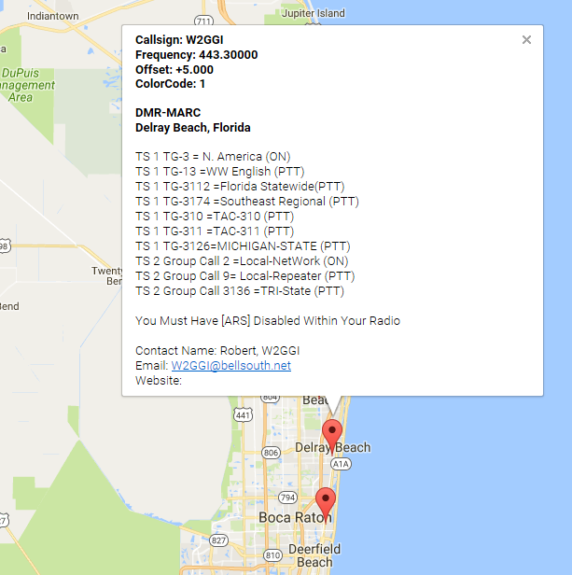
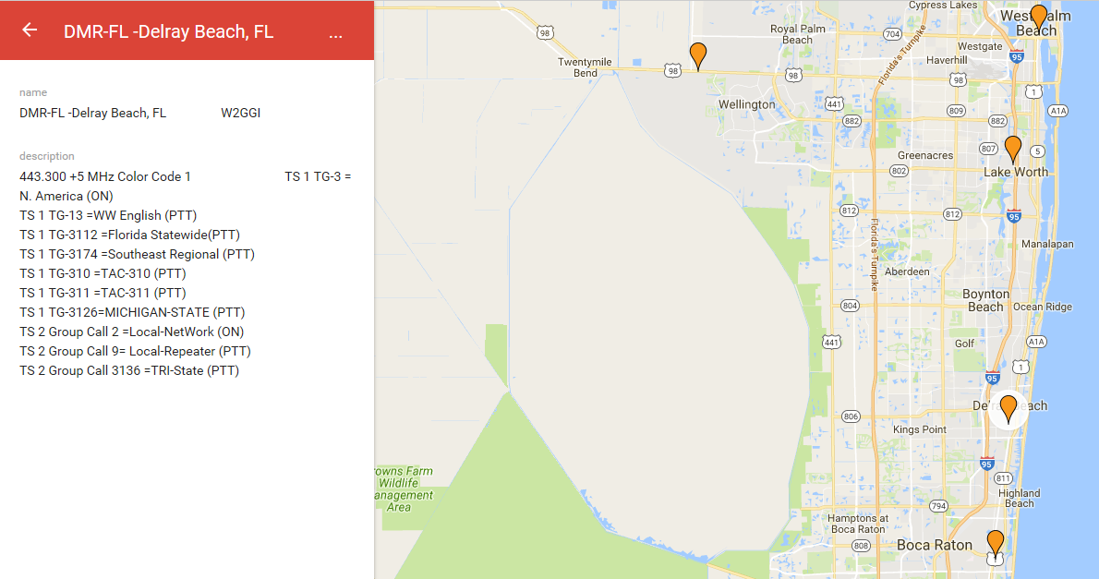
DMR for DUMMIES
http://www.dmr-marc.net
http://dmr-ecs.org

Slide 9
DMR for DUMMIES
Zones
User DMR radios support Zones. A Zone is just a grouping of individual channels. Some model radios may limit the number of channels per Zone and the number of Zones allowed. TYT and CS limit is 16 channels per Zone.
You could program Zones for local channels (DMR or analog), another Zone for a neighboring state, and a Zone for business and government channels. If you do program non-amateur channels in your radio, make sure they are RX only unless you are licensed or authorized to use them as per FCC 90.427(b); otherwise you will be in violation of FCC R&Rs and enforcement action could be taken against you. If you have a VHF model, you could program a Zone for all the possible NWS Weather Channels (again, make sure you program the channels as receive only).
Zones are just a way to manage large number of channels, much like file folders or directories on your computer. You may want to equate Zones with Repeaters.

Slide 10
DMR for DUMMIES
Color Codes
DMR repeaters use Color Codes (CC) much like analog repeaters use CTCSS (PL) or DCS. To access a repeater you must program your radio to use the same CC as the repeater. There are 16 different CCs (CC0-CC15).
The use of Color Codes is not optional on DMR systems. If your Color Code is not set correctly, you will not be able to access the repeater.
The only real purpose of using different Color Codes is when multiple repeaters operating on the same frequency have overlapping coverage areas.
Note: CC1 is most often used in Florida.

Slide 11
DMR for DUMMIES
Code Plugs
A code plug is simply a radio’s configuration file.
Using a manufacturer’s programming software you configure the channels and operating parameters of a radio. This file is uploaded to the radio and typically should also be saved on you computer as a backup. You can also download the code plug from a radio to modify it.
Building a code plug can take many hours, especially if you want to program hundreds of channels.
The code plug can also contain a Contact List of Radio IDs, call signs, and names to be displayed. You can find copies of configured code plugs on the web for different models of radio; check out the different Yahoo DMR groups. All DMR radios support a limited number of entries in the Contact List; you can download Code Plugs with the Contact List populated using a generator on the DMR-MARC home.

Slide 12
DMR for DUMMIES
Scanning
All DMR radios allow you to configure scanning of channels.
Remember, you will only hear traffic on the frequency, time slot, and groups you have programmed on a channel.
Typically you scan both time slots on my local repeater and a simplex channel.
You can also scan analog channels mixed with the digital channels.
Scanning will decrease the battery life on your radio.

Slide 13
DMR for DUMMIES
Roaming
Roaming is not supported on all DMR radios. Check your owner’s manual or manufacturer website to see if roaming is supported. In some radios it may be an additional cost option.
Roaming is NOT scanning. Roaming is similar but different. Roaming is designed to have your radio automatically select the best channel if your current channel’s Receive Signal Strength Indicator (RSSI) falls below a defined level as you move throughout the coverage area of a group of repeaters that carry the same Talk Groups on the same time slots. You should select channels that have the same time slot and receive groups configured; if you do not, roaming may not work correctly. Repeaters can be configured to transmit beacons at predefined intervals of inactivity so roamers will be on the correct channel. Without the repeater beacons, roaming will still work, but the radio will only change channels if it hears a repeater on the air.
Roaming would be really great if all the DMR repeaters were on the same set of repeater pairs across the country, but it is too much to expect the Repeater Councils to work together for a unified rebanding of existing coordinations. It would also help if the different DMR networks could agree on which time slots were used by which Talk Groups, on the same time slots in your radio and be able to travel across North America and be able to access all DMR repeaters?

Slide 14
DMR for DUMMIES
Simplex
On the professional side of DMR, Talk-Around refers to operating simplex on a repeater output channel. This allows a direct communication while still being able to hear the repeater. This allows users to directly contact other users listening on the repeater output frequency. Amateurs typically use dedicated simplex channels so as not to interfere with repeaters. The amateur DMR community has published a list of recommended simplex frequencies to be used instead of operating simplex on repeater outputs:
UHF
1) 441.000
2) 446.500
3) 446.075
4) 433.450
VHF
1) 145.790
2) 145.510
[Use TG99 / CC1 / TS1 /Admit Criteria: Always / In Call Criteria: TX or Always]
Do not use 146.520 or 446.000; they are the national analog simplex channels and operating DMR on these common analog use frequencies will just cause disharmony within the amateur community. Also, avoid repeater inputs and outputs, locally used non-DMR simplex channels, satellite sub-bands, and any other frequencies that could disrupt other amateur communications.

Slide 15
DMR for DUMMIES
Admit Criteria
The Admit Criteria determines when your radio is allowed to transmit.
The recommended setting for DMR repeater channels is Color Code Free; this configures your radio to be polite to your own digital system. You should configure your In Call Criteria to Follow Admit Criteria.
Simplex channels should be configured as Always for both Admit Criteria and Always or Follow TX for In Call Criteria.
Analog repeater channels should be configured as Channel Free

Slide 16
DMR for DUMMIES
Accessing a DMR Repeater
When you want to access a DMR repeater, you must have the frequency, Color Code, and Talk Group set correctly. When you key your transceiver, you send a signal to the repeater and the repeater responds back to you to acknowledge you can transmit your message. If you do not receive the repeater’s acknowledgement, your radio will stop transmitting and you will hear a negative confirmation tone. This is one of the advantages of TDMA: allowing bidirectional communications between user and the repeater when transmitting. The repeater can also signal your radio to stop transmitting if there is contention on the network because more than one station is transmitting at a time.
Not all DMR repeaters are interconnected on the Internet. Internet connectivity may not be available at the repeater site, or not available at a reasonable cost. Some repeater operators may just prefer to keep their repeater for local usage only, or maybe only want it connected to a small local/regional network, without connecting to the larger world wide networks.

Slide 17
DMR for DUMMIES
Analog
Frequency Pair (440 + 5.0 offset)
25.0 kHz Bandwidth
1 full bandwidth slot
-
-
Repeater
Sub Auditable Tones [CTSCC (PL) or DCS]
Program/Configuration File
DMR (Digital Mobile Radio)
Frequency Pair (440 + 5.0 offset)
TDM 12.5 kHz:
2 Time Slots [TS1, TS2]
Talk Groups [TG]
Group Contacts
Private Calls
All Call
Zones
Color Codes [CC0-CC15]
Code Plug
Admit Criteria
Color Code DMR
Always Simplex
Channel Free Analog
Programming your DMR Radio

Slide 18
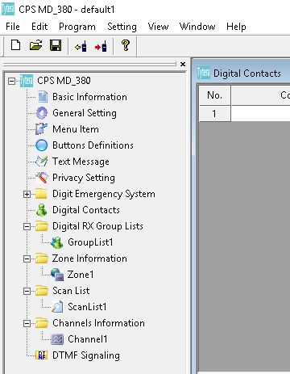
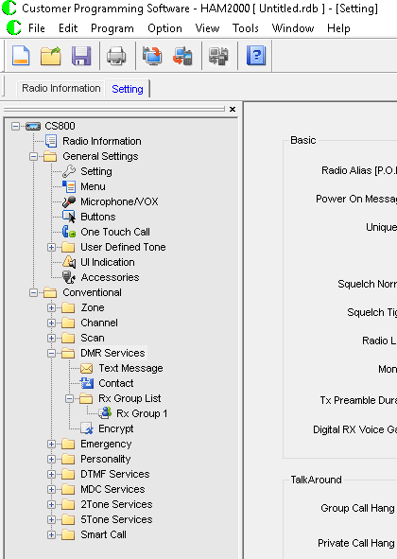
DMR Programming for DUMMIES
MD 380/390
CS-750/800
General Setting / Setting
Menu Items / Menu
Buttons Definitions / Buttons
Text Message / Text Message
Digital Contacts / Contacts
Digital RX Groups / RX Group List
Channels Information / Channel
Zone Information / Zone
Scan List / Scan

Slide 19
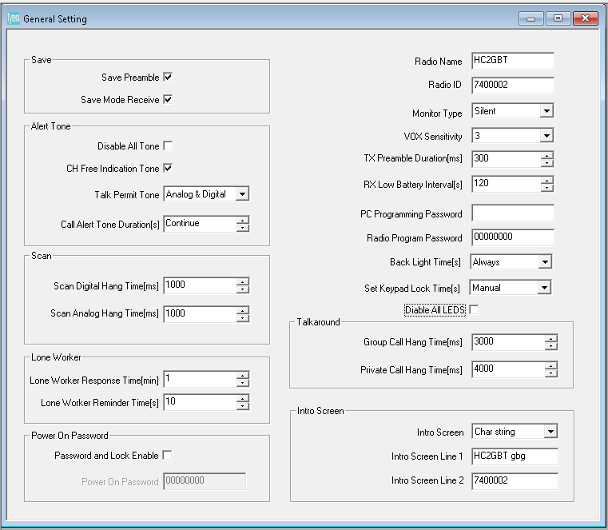
DMR Programming for DUMMIES
General Settings
Radio Name: your call sign
Radio ID: your 7 digit DMR ID
Intro Screen Line 1: your call sign and name (up to10 digits)
Intro Screen Line 2: your DMR ID or name

Slide 20
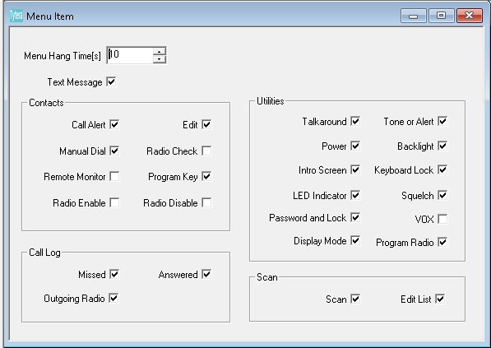
DMR Programming for DUMMIES
Menu Items
Verify checked items

Slide 21
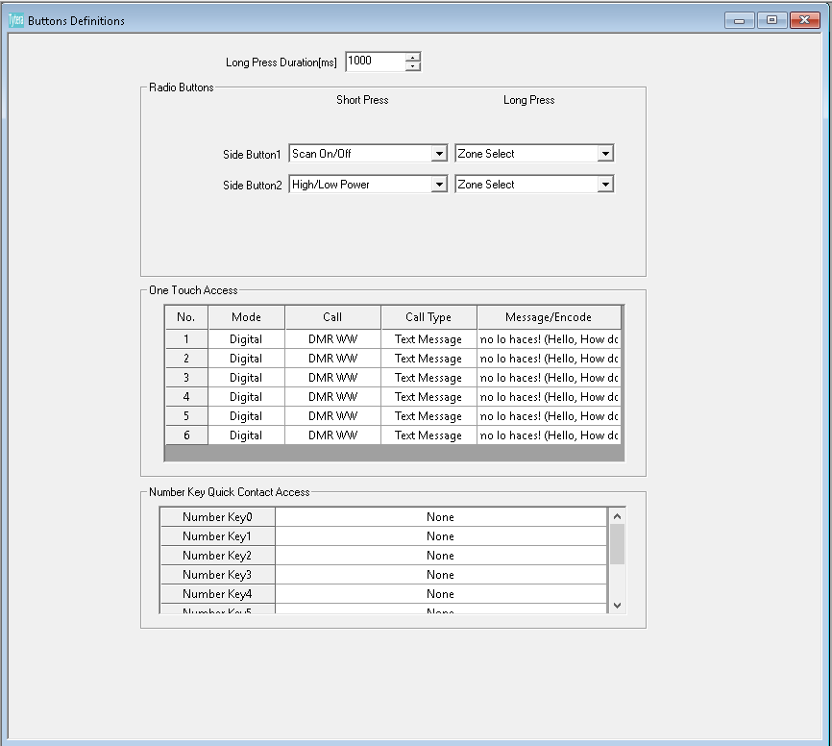
DMR Programming for DUMMIES
Buttons Definitions
Select Short/Long Press and Side Button settings
These may vary by personal preference
Note: CS 750/800 have more options

Slide 22
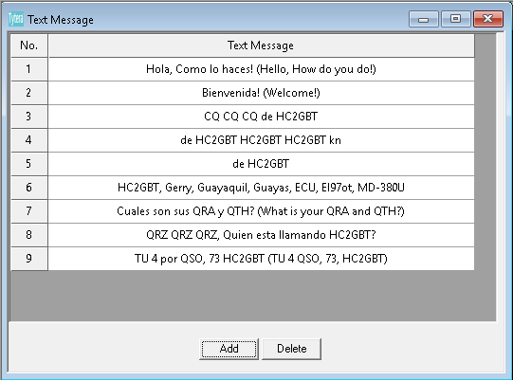
DMR Programming for DUMMIES
Text Message
Personal Selection

Slide 23
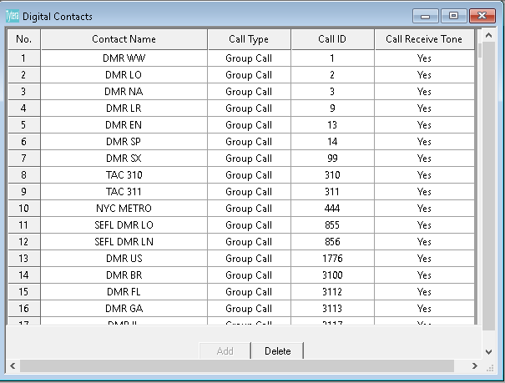
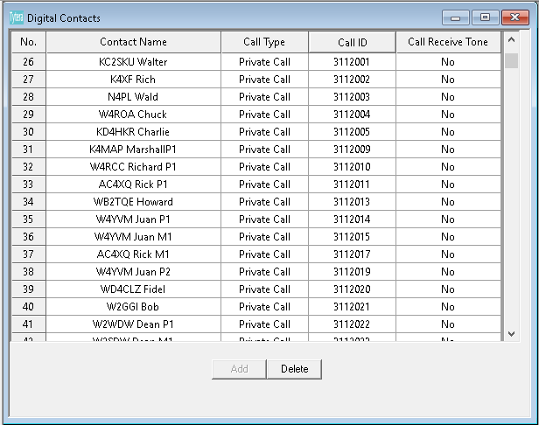
DMR Programming for DUMMIES

Slide 24
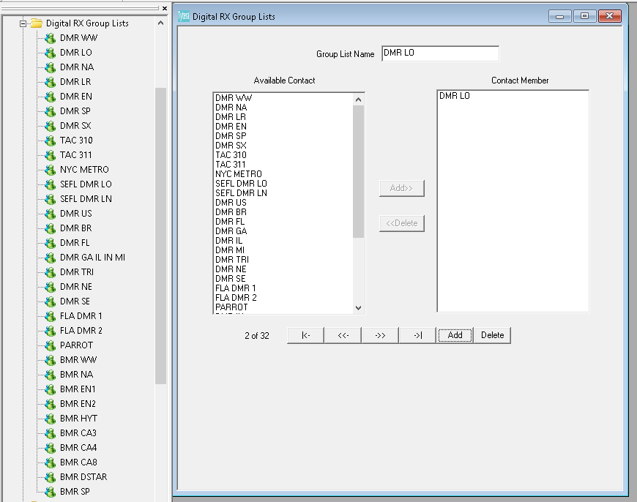
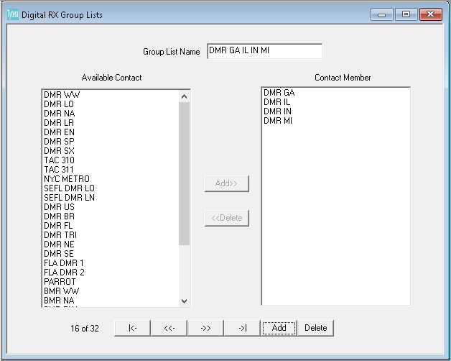
DMR Programming for DUMMIES
Digital RX Groups
You need one for every Talk Group
You may combine Talk Groups under on RX Group List.
See DMR GA IL IN MI

Slide 25
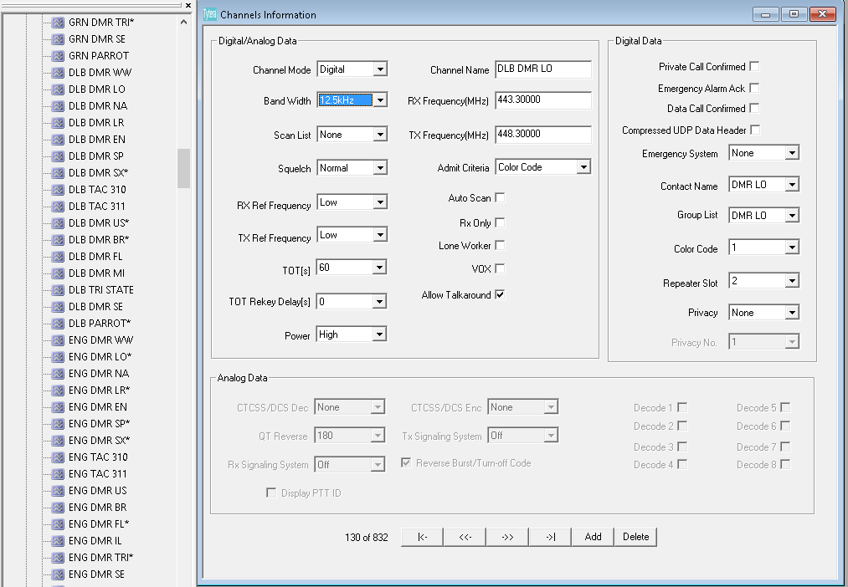
DMR Programming for DUMMIES
Channels Information
Digital Analog Data-1st Column
Channel Mode (digi/analog)
Band Width (12.5 or 25.0)
Scan List
Power (hi/lo)
Analog Data
CTCSS/DCS Dec/Enc

Slide 26
DMR Programming for DUMMIES
Channels Information
Digital Analog Data-2nd Column
Channel Name (DLB DMR __)
RX Freq (443.30000)
TX Freq (448.30000)
Admit Code (Always/Channel Free/Color Code)
Allow Talkaround (on repeaters only)

Slide 27
DMR Programming for DUMMIES
Channels Information
Digital Analog Data-3rd Column
Contact Name(DMR __)
Group List (DMR __)
Color Code (0-15)
Repeater Slot (1-2)

Slide 28
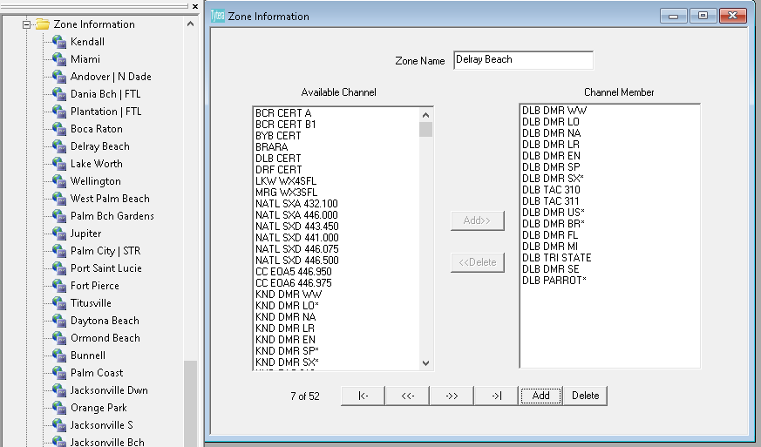
DMR Programming for DUMMIES
Zone Information
Zone Name
Up to 16 Channels per Zone
Non Active Channels indicated by:
* MD 380/390
X CS 750/800

Slide 29
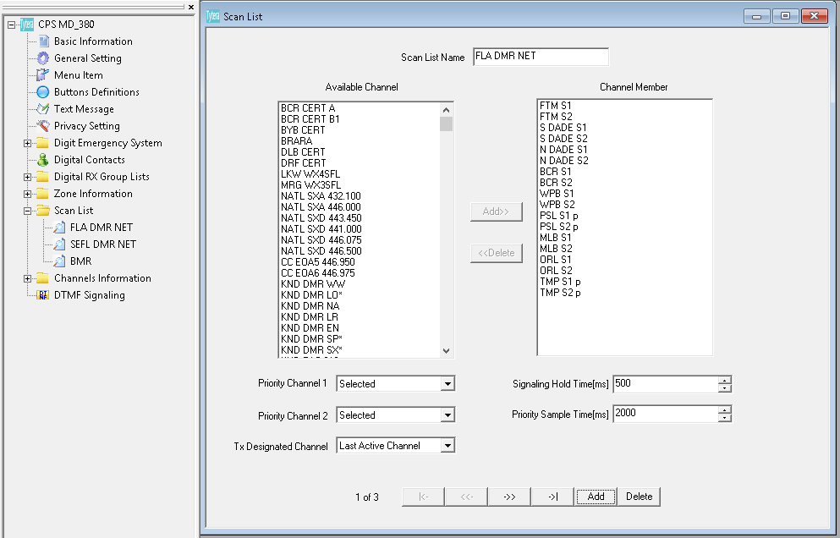
DMR Programming for DUMMIES
Scan
Scan List Name
Not limited 16 Channels per List
Priority Channels are Optional

Slide 30
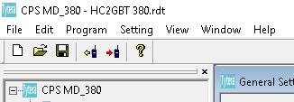
DMR Programming for DUMMIES
Remember to Save your Work by either:
File
Save
Save as
Selecting the Floppy Disk
Save
Otherwise your work will not be saved

